Slide 1

Diversity Mark Annual Summit
EDI 2.0 - from Action to Impact
Tuesday 8th October 2024 Titanic Belfast
9.00am – 4.00pm

Slide 2
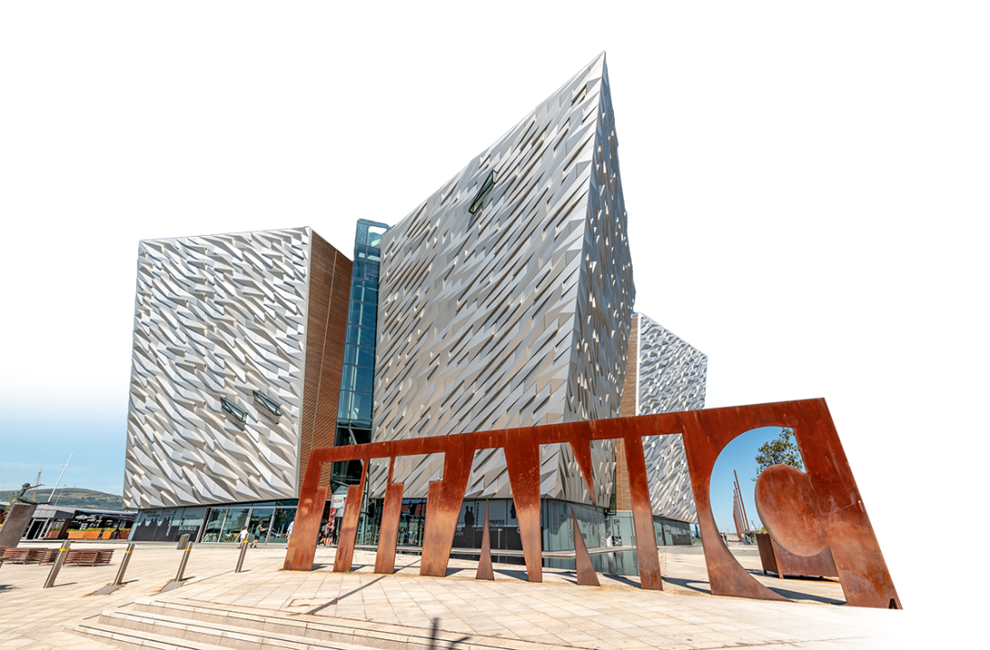

Diversity Mark Annual Summit
EDI 2.0 - from Action to Impact
Diversity Mark proudly presents the Diversity Mark Annual Summit, uniting Northern Ireland’s forward-thinking organisations committed
to fostering inclusive workplaces. Sponsored by Allstate Northern Ireland, this transformative one-day event revolves around the theme ‘EDI 2.0 - from Action to Impact.’
Set against the iconic backdrop of Titanic Belfast, on Tuesday 8th October 2024, this thought-provoking summit promises to
inform, support and inspire over 300 business and diversity leaders.
Attendees will engage with expert keynote speakers, benefit from panel sessions offering global and local perspectives, and immerse themselves in educational breakout sessions. Delegates can anticipate gaining invaluable insights and a wealth of resources to drive diversity and inclusion within their organisations.
By harnessing these tools, attendees will be equipped to spearhead positive change and innovation
in their workplaces.
By harnessing these tools, attendees
will be equipped
to spearhead positive change and innovation in their workplaces.

Slide 3
Diversity Mark Annual Summit
EDI 2.0 - from Action to Impact
Summit Agenda
09.00 Arrival refreshments & networking
09.45 Welcome from Carolyn Stewart, Summit host
09.55 Sponsor’s Message - Dr Stephen McKeown Vice-President and Managing Director, Allstate Northern Ireland
10.00 Minister for the Economy, Conor Murphy MLA
10.10 Keynote Speaker, Professor Tim Soutphommasane - EDI 2.0 Chief Diversity Officer and Professor, University of Oxford
11.10 Mid-morning refreshments break with networking
11.35 John Healy OBE Chair, Invest Northern Ireland
Building a Better Society: The Business Case for Inclusive Growth
11.50 Panel session facilitated by Judith Gillespie CBE Co-Chair, Diversity Mark Assessment Panel
Transforming Talk into Tangible Change: EDI Strategies that Work
Caroline Van Der Feltz, HR Director, Danske Bank
John Healy, Chair, Invest Northern Ireland
Shauna McPeake, Director of People and Culture, Catalyst
Aisling Quinn, Director, NI Civil Service
12.30 Breakout session 1
Delegates can choose one session to attend before lunch and after, the same sessions will be repeated after lunch
Cultural Reflection and Inclusion: Embracing different cultures, including our own Lata Sharma, writer, actress, singer, journalist, and a Belfast girl of Indian heritage
The Power of Community Engagement and Partnerships Dr James Uhomoibhi, Lecturer, Ulster University
The winning formula: The Impact of Employee Resource Groups and Champions
13.15 Lunch

Slide 4











Diversity Mark Annual Summit
EDI 2.0 - from Action to Impact
Conference Agenda
14.15 Breakout session 2
Cultural Reflection and Inclusion: Embracing different cultures, including our own Lata Sharma, writer, actress, singer, journalist, and a Belfast girl of Indian heritage
The Power of Community Engagement and Partnerships Dr James Uhomoibhi, Lecturer, Ulster University
The winning formula: The Impact of Employee Resource Groups and Champions
15.00 Panel session facilitated by Chloe Gillard Diversity, Inclusion & Belonging Manager, Version 1
From Strategy to Impact: Transforming Recruitment for Greater Inclusion
Laura Dowie, Director, Timely Careers
Lisa McIlvenna, Deputy Managing Director, Business in the Community NI
Mark McAlister, CEO, The Labour Relations Agency
15.30 Closing session
The Power of Inclusion: My Journey from Refugee to Advocate
15.55 Close of conference by Christine White
Director, Diversity Mark
Supporting sponsors:
Supported by:

